Slide 1

DIGITAL IMAGE PROCESSING submitted by Omkar V. Patil 2GI21CS106
Karnatak Law Society’s
GOGTE INSTITUTE OF TECHNOLOGY
UDYAMBAG, BELAGAVI-590008
ACTIVITY REPORT ON

Slide 2
ABSTRACT
Computer digital image technology is a very important branch of the computer application discipline, and its application areas include measurement, computer-aided design, physics, three-dimensional simulation and other industries. Moreover, with the improvement of computer hardware performance, image processing algorithms have improved the application of digital image processing technology. This article focuses on the current digital image processing technology and its application status

Slide 3
Introduction
Digital image processing technology is the use of computer technology to remove the image noise, enhance, segmentation, recovery and so on. The development of computer network technology has led to the development of digital image processing technology, the increasing level of mathematics, and the constant demand for digital image processing technology from various industries in society, which has brought new opportunities for digital image technology and provided advancement. In the 1920s, human beings used digital image processing technology for the first time. They used cables to transfer photos between the United Kingdom and the United States. However, the quality of images transmitted was not very good. Therefore, image quality should be improved and optimized. It was not until the 1970s that digital image processing technology had been updated. As technology is continuously updated and applied to different fields, the requirements for digital image processing technology are getting higher and higher, which also accelerates the development of digital image processing technology.

Slide 4
OVERVIEW
Digital image processing, also known as computer image processing, refers to the process of converting an image signal into a digital signal and processing it with a computer. This process includes image enhancement, noise reduction, segmentation, restoration, encoding, compression, and extraction of features. The process of digital image processing is shown in figure 1. Image processing technology cannot be developed without the development of computers, the development of mathematics, and the growth of application requirements in various industries. In the 1960s, the image processing technology began to be applied more scientifically, and people used this technology to perform idealized processing of output images.

Slide 5
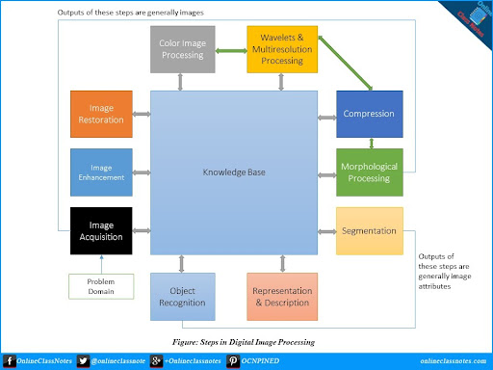
PROCESS FLOW DIAGRAM

Slide 6
APPLICATIONS OF DIGITAL IMAGE PROCESSING
FIELD | APPLICATION
Physics and Chemistry | Spectrum Analysis
Biology and Medicine | Cell analysis, CT,X-ray
Environment Protection | Research of atmosphere
Agriculture | Estimation of plants
Irrigation works | Lake, river and dam
Economics | IC-card
Weather | Cloud and weather report

Slide 7
CONCLUSION
To sum up, this paper first analyzes the research status and major application fields of digital image processing technology, and then studies the development trend of digital image technology. At present, digital image processing technology has been widely used in life. For example, applications in networks, mobile phones, etc., the development of digital image processing technology is closely related to people's lives. With the continuous development of technology, digital image processing technology will continue to be obtained. Progress, these also need more people to study.

Slide 8
REFERENCES
Advances in Intelligent Systems Research, volume 163
8th International Conference on Management, Education and Information (MEICI 2018) , the Authors. Published by Atlantis Press.

